Slide 1


NAIVE BAYES
CLASSIFIER
NAIVE BAYES CLASSIFIER
Angelica Madera & Sameeha Ahmed
Notes:
Angelica & Sameeha

Slide 2

THE DATASET
What is the dataset? | Reviews from visitors who have visited Disneyland branches in Paris, California, or Hong Kong posted on Trip Advisor.
How many samples? | Total # of samples: 42,656 reviews
How many labels? | Total # of labels: 5 (1, 2, 3, 4, 5)
How many samples are there in the training set? | Total # of samples in training set: 34,125 reviews
How many samples are there in the test set? | Total # of samples in test set: 8,531 reviews
Quirks? Issues? Inconsistencies? | Spelling errors and labeling vs. written feedback
Did you have to do some additional preprocessing? | Lowercase, stop words, tokenization, and stemming
Notes:
Sameeha

Slide 3
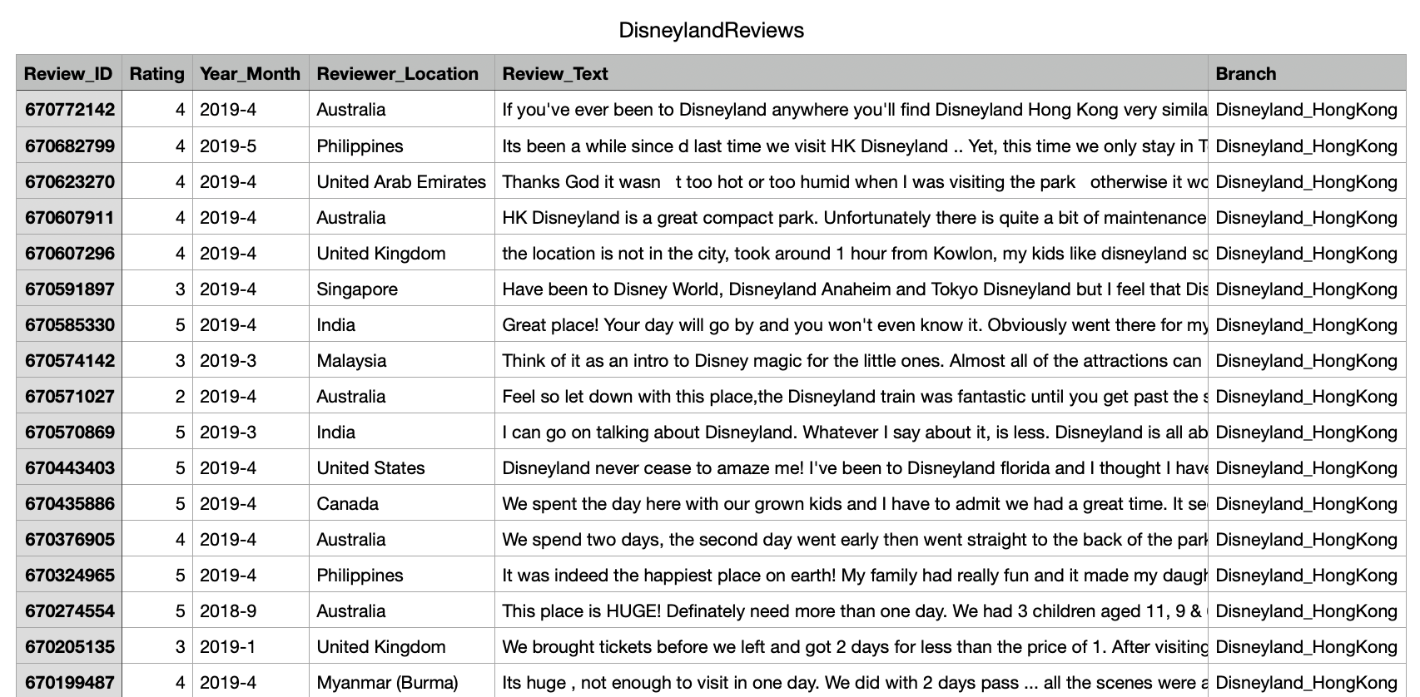
Notes:
Sameeha

Slide 4
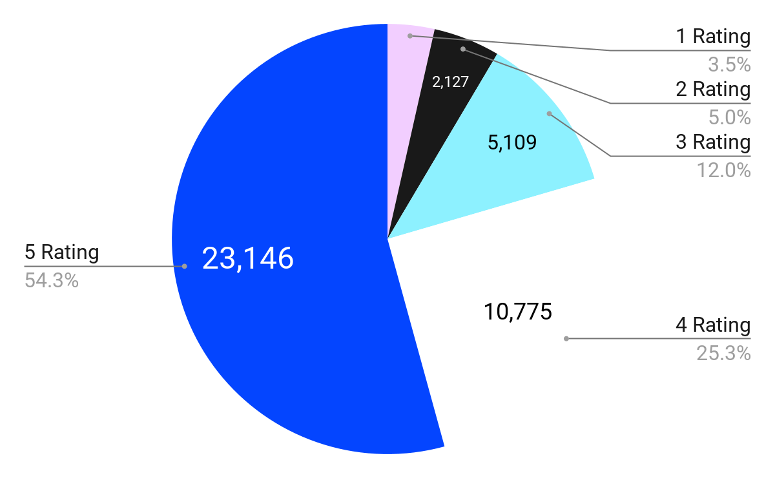
Disneyland Review Ratings Distribution
1419
A total of 42,656 reviews
Notes:
Sameeha

Slide 5
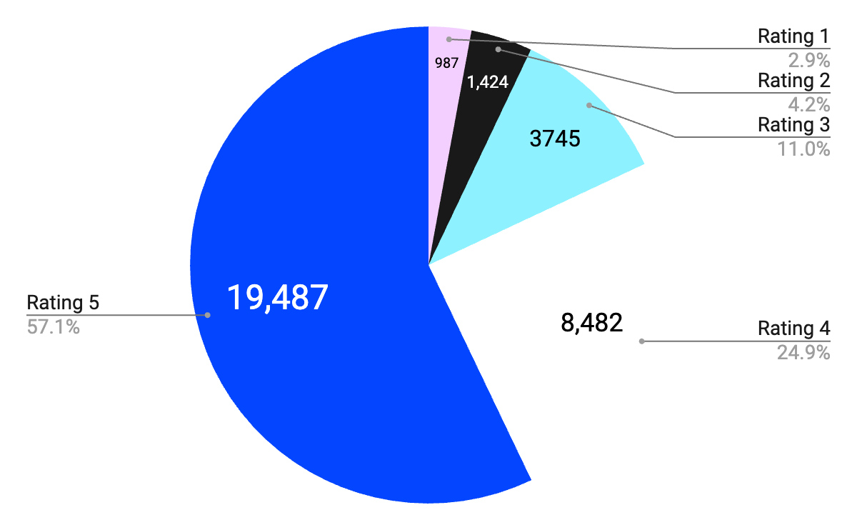
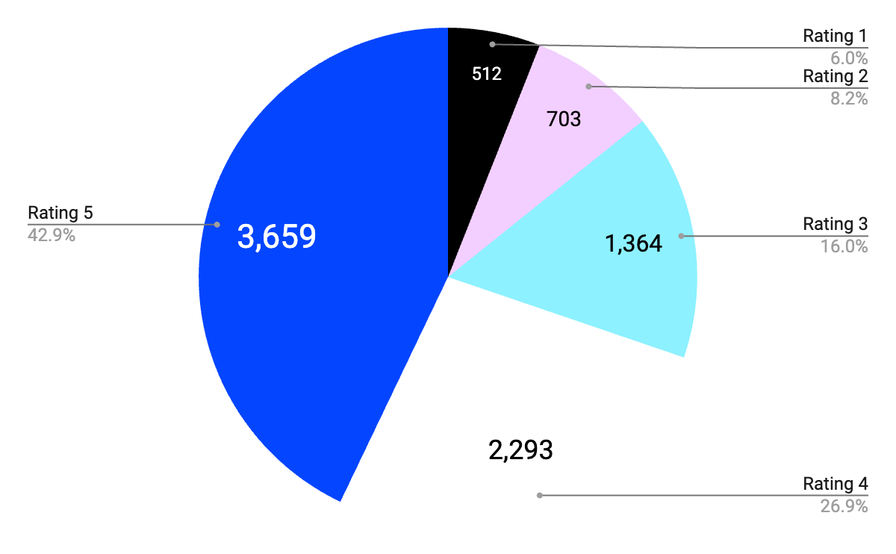
Training Set Ratings Distribution
Test Set
Ratings Distribution
Total of 34,125 reviews
Total of 8,531 reviews
Notes:
Sameeha

Slide 6
OUR APPROACH: Training Functions
data(csv file):
takes in a csv file
80% of the set in training_data dictionary (only rating and review)
other 20% of the set in testing_data dictionary (only rating and review)
returns training_data and testing_data training_dat
vocabulary(rating, filtered review):
AKA our binary bag of words
for loop word in filtered review:
If word is already in bagOfWords dict:
Increment BagOfWords[word]
else:
Add bagOfWords[word]
Increment wordCount
training(training_data):
reviewCount = len(training_data)
For loop in range(reviewCount):
Add count to reviewRating dictionary
filtered review = preprocess(review)
vocabulary(rating, filtered review)
Notes:
Pass training dataset in training function
Where we capture total number of reviews in that training dataset
We preprocess the review text for every single review in our set
keeps count of how many reviews there are per rating
And we pass the filtered review and the rating to the vocabulary function
Which is where we maintain our bag of words dictionary
If the word does exist in the bag of words, we increment count
else, we add the word to the dictionary

Slide 7
OUR APPROACH: Test Functions
test(test_data):
reviewCount = len(test_data)
For loop in range(reviewCount):
filtered review = preprocess(review)
for x in range(5):
probability(rating, filtered sentence)
chosenRating = max rating probability
increment confusionMatrix[rating][guessedRating]
probability(rating, filtered sentence):
ratingProb(rating)
for loop word in filtered sentence:
if word in bagOfWords:
wordProb(word, rating)
else:
skip
Add probabilities and inverse log for final probability
ratingProb(rating):
log(total # of reviews per rating / total # of reviews)
wordProb(rating, word):
log(frequency of word in rating / total # of words in rating)
Notes:
Once training is done, we move to our test function
Takes in test dataset
We once again, calculate the total number of reviews in that set
starts by preprocessing each review
For each review, we calculate the probabilities per each rating
Once we find those numbers, out of those five probabilities, we choose the rating with the highest probability
we increment our confusion matrix accordingly with our guessed results.
We developed the probability function to calculate the probability of each filtered review given a rating
ratingProb and wordProb
Just helper functions to calculate both the probability of a review being labeled a rating and probability of a word given a rating respectively

Slide 8
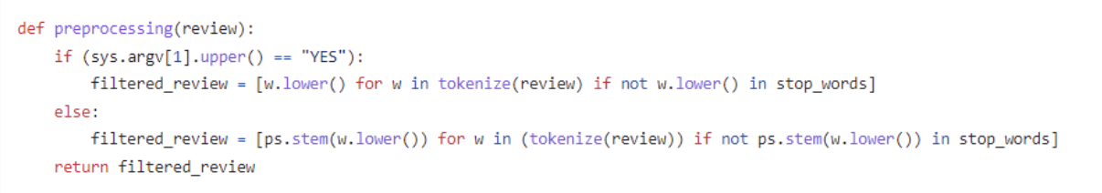
Our Approach: Switching to a Different Model
Notes:
Angelica
This is our actual preprocessing function we have in our code
Which uses a condition statement to determine what type of model we will train and test against
If the user inputs yes, it will ignore stemming
Else, it will proceed with incorporating stemming

Slide 9

Python Libraries & Packages
csv
NLTK
nltk.corpus
nltk.stem
nltk.tokenizer
math
Log space calculations
NumPy
Mathematical functions when calculating probabilities
Matplotlib
Plot roc curve
Notes:
At the end, we did end up using a handful of python libraries and packages, which includes
csv library to read in our dataset
nltk to preprocess the review text
math library to use log function when calculating log space
NumPy to use really basic functions like finding the product or sum or all elements in an array
Matplotlib to plot our roc curve

Slide 10
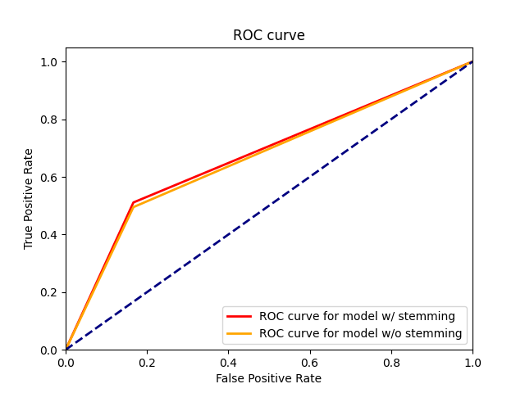
OUR EVALUATION: ROC Curve
Notes:
Sameeha

Slide 11
OUR EVALUATION: Confusion Matrix
Ignore Stemming
Perform Stemming
 |  | Predicted Label
 |  | correct label | incorrect label
Actual Label | correct label | TP = 844.6 | FN = 4308.0
 | incorrect label | FP = 614.6 | TN = 1,108.6
 |  | Predicted Label
 |  | correct label | incorrect label
Actual Label | correct label | TP = 872.2 | FN = 4170.0
 | incorrect label | FP = 601.1 | TN = 1067.0
Notes:
Sameeha
Slide 4: Evaluation
- ROC curve(s) for both models (best to do it on one plot to make it easy to compare)
- Confusion matrix/matrices for both models
- metrics for both models

Slide 12
OUR EVALUATION: Metrics
Ignore Stemming
Perform Stemming
Sensitivity: 0.4706828532850295
Specificity: 0.8341881116099966
Precision: 0.4180404889808784
Negative Predictive Value: 0.8412548129372203
Accuracy: 0.7532575390433075
F-score: 0.14039618488628028
Sensitivity: 0.47424693171705795
Specificity: 0.8340023919949953
Precision: 0.42876253743611736
Negative Predictive Value: 0.8407342508136996
Accuracy: 0.756581100145808
F-score: 0.14197619389072136
Notes:
Sameeha

Slide 13

SUMMARY / FINAL THOUGHTS
How skipping stemming impacted our results
Data was skewed
More positive ratings vs negative ratings
Challenges with underflow
Applied log space calculation
Improvements
Optimization
Utilizing additional Python libraries
Notes:
Angelica & Sameeha
Stemming helped get root words of the words within each review. This in turn helped us fix some of the spelling mistakes that occurred in the dataset. So using that as a preprocessing step benefited our results.
Some expectations we had in regards to our dataset where to have more positive ratings vs negative ratings. And our results prove this point. There were more ratings that were labeled 5 or 4 compared to ratings labeled 1, 2, or 3.
Challenges we faced while coding this classifier was trying to find solutions against the and to make a confusion matrix for a multiclass. Since we worked with two classes in lecture and our written assignment, constructing a matrix of 5 classes was a bit challenging, but making one for this dataset gave us an opportunity to overcome that challenge.
Improvements we can potentially make to our classifier are:
Using less data structures. A lot of dictionaries and arrays were used when developing this model, and I think if we had more time, we could have cleaned up our code to be more memory efficient.
Also, we sort of realize this late, but this assignment also posed a lot of opportunities to utilize a few other python libraries and possibly even optimize the runtime of our implementation. For example, we could have used the dask library to parallelize our data structures.

